Slide 2
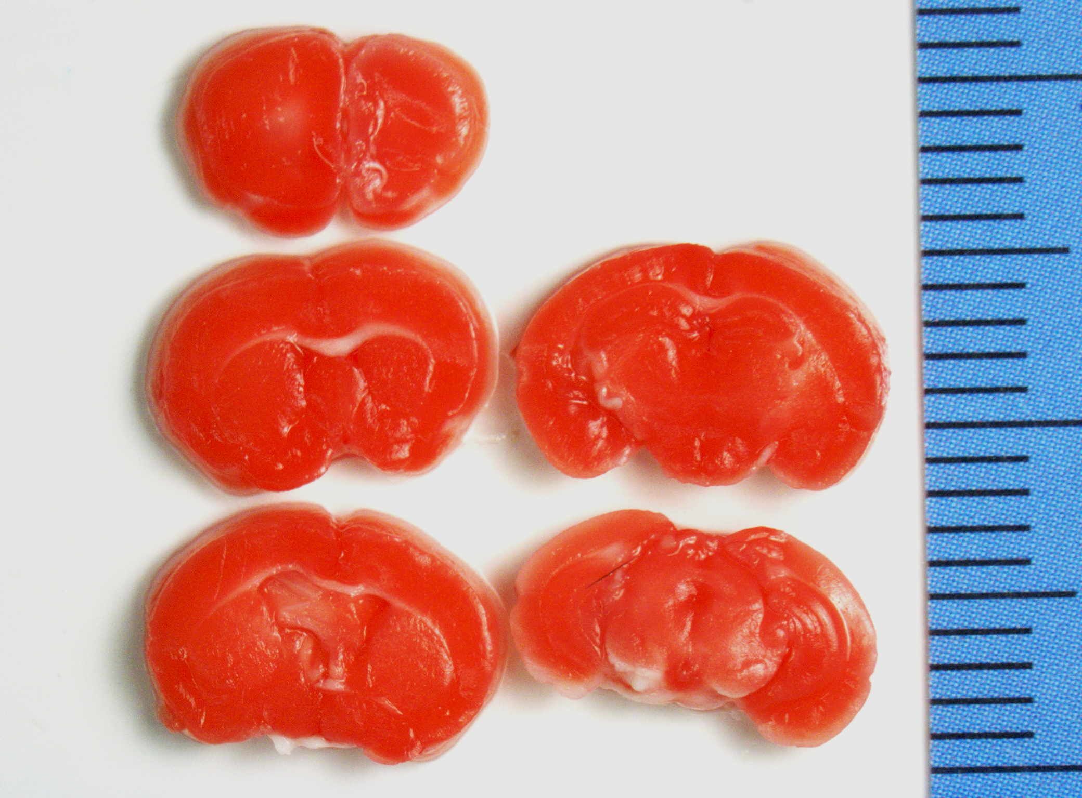
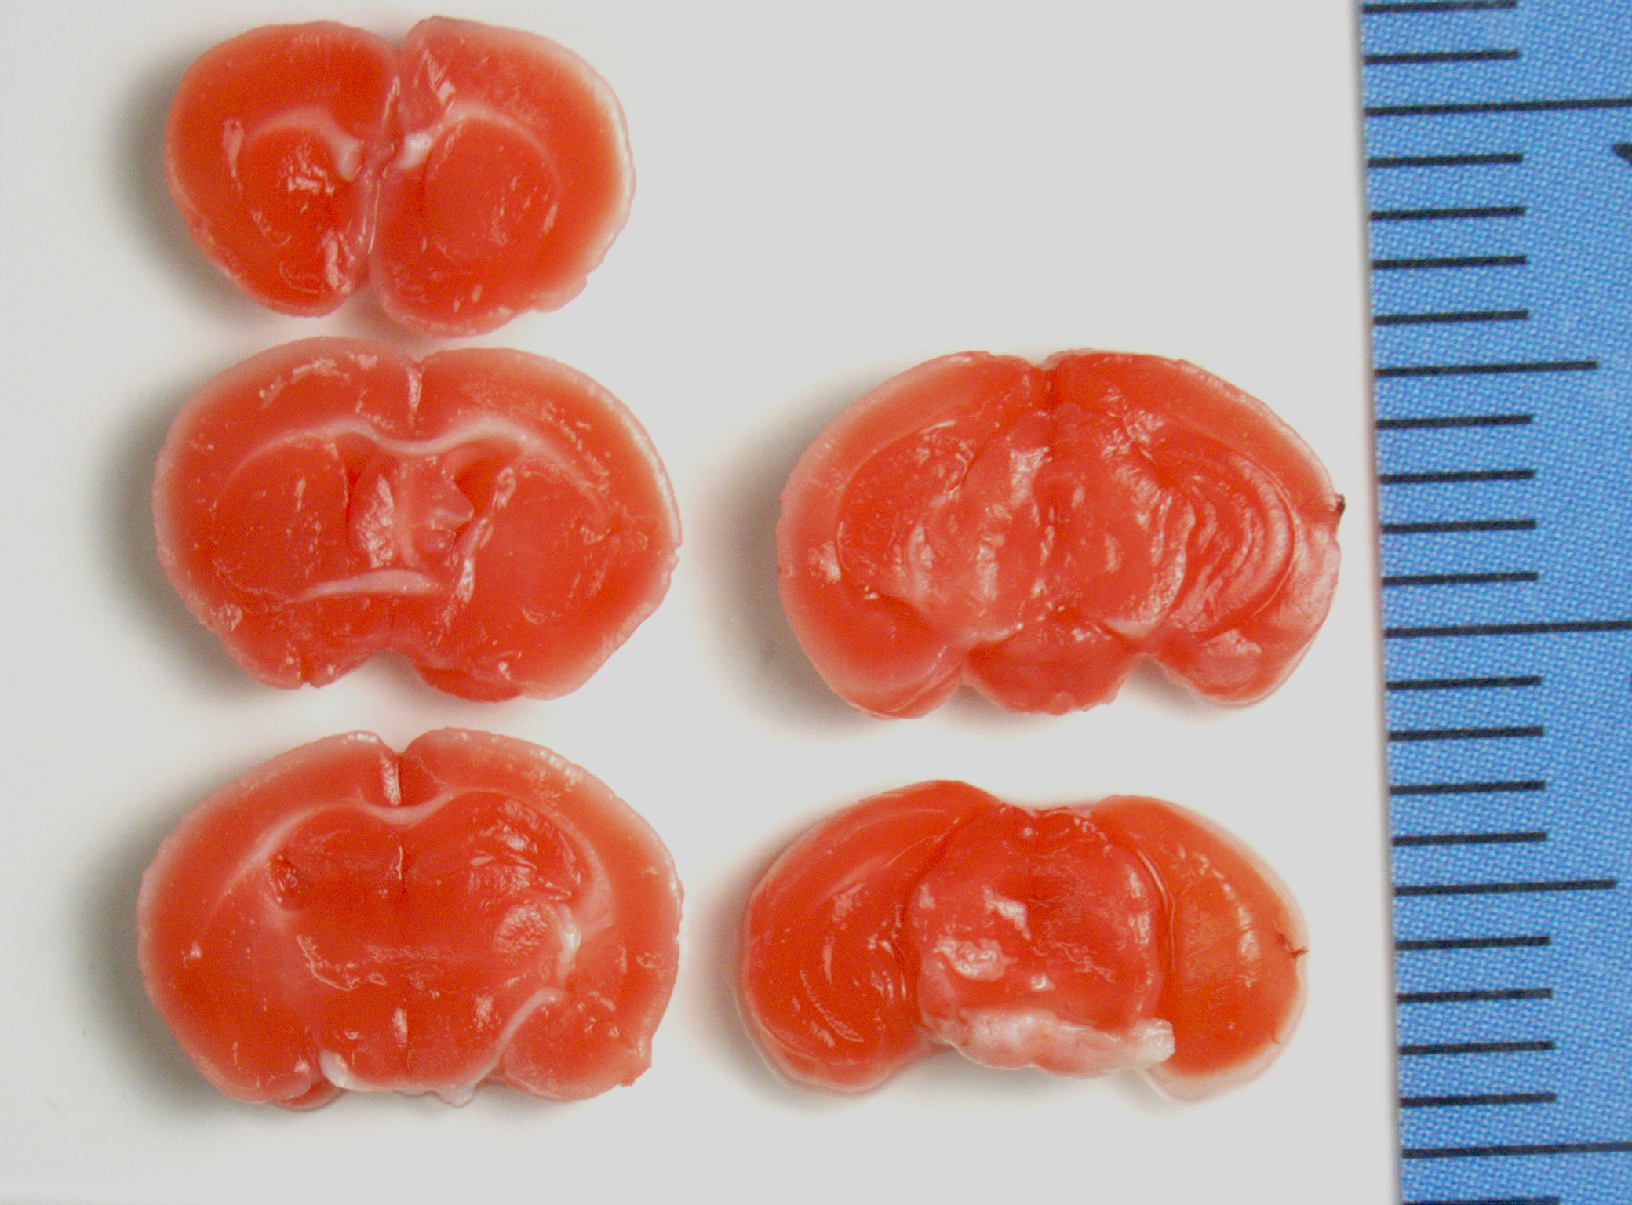
Ms.3327(female, 48 hours after MCAO)
Stroke volume: 0mm³

Slide 3
Ms.3327(female, 48 hours after MCAO)
Stroke volume: 0mm³

